Slide 1


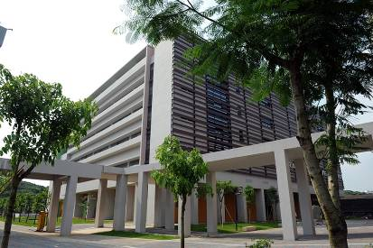
Engineering Electromagnetics 工程电磁场
Youwei Jia 嘉有为

Slide 2

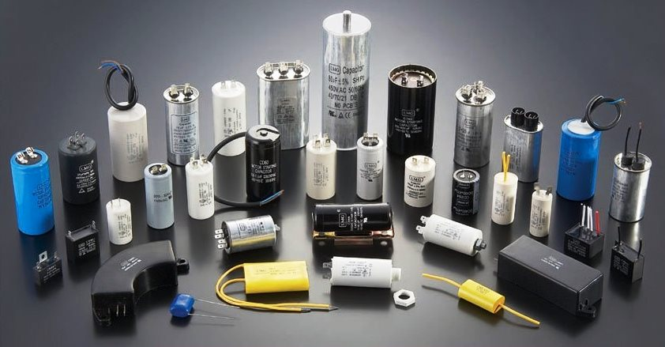
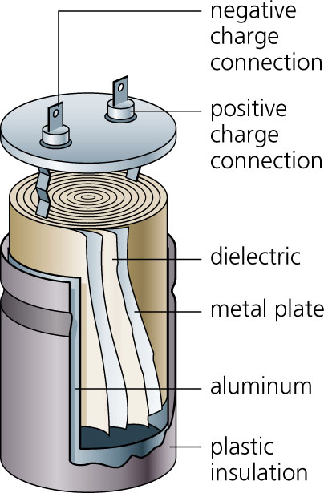
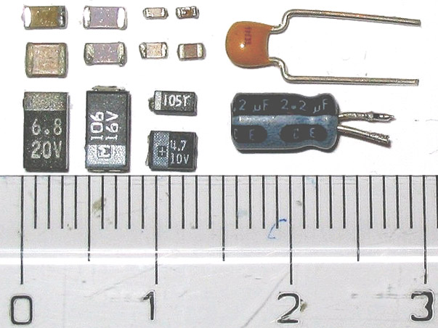
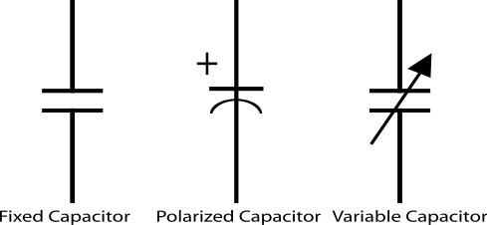
10: Capacitance
Capacitor Vs Capacitance 电容（器）？电容？
1

Slide 3
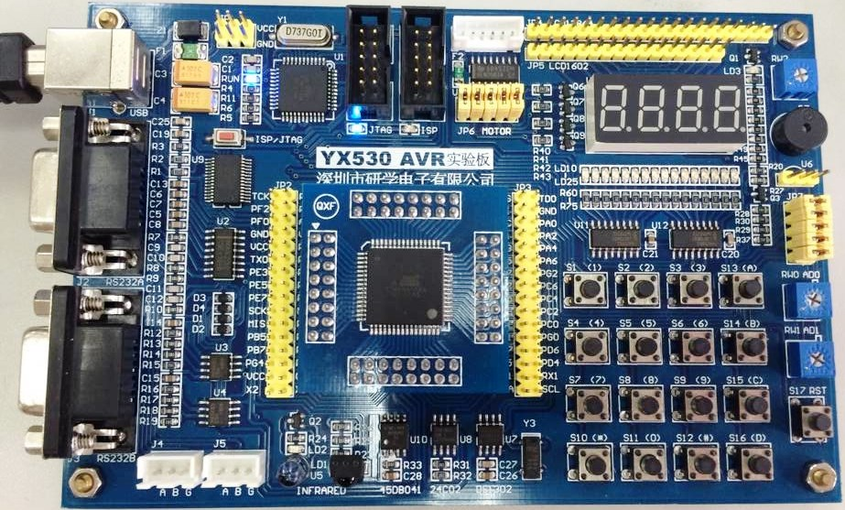
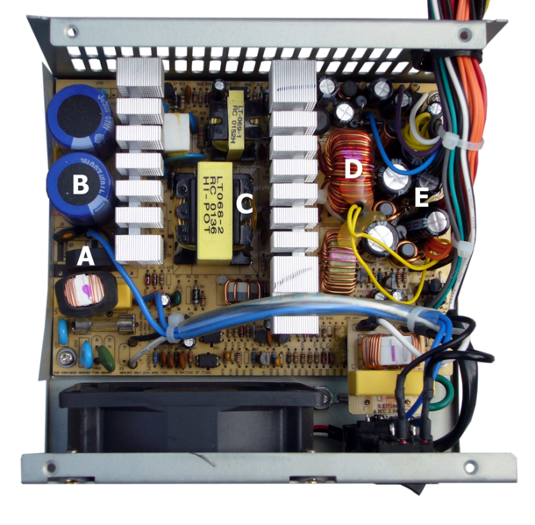
10: Capacitance
Capacitor Vs Capacitance 电容（器）？电容？
A capacitor is a electrical component / device 元器件 used to store electric energy (electric flux, electric field, electric charge).
Most of time, capacitors are purposely designated to perform specific functions, but sometimes, capacitance may exist as an unavoidable by-product of the device structure. Parasitical Capacitance 寄生电容
2

Slide 4
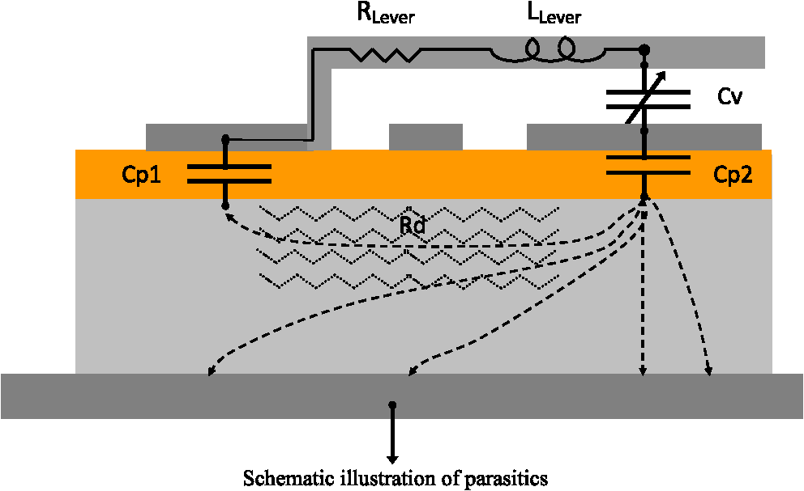
10: Capacitance
Capacitor Vs Capacitance 电容（器）？电容？
Parasitical capacitance in semiconductor devices
Capacitance is a physical quantity used to measure the capability of energy storage in electrical devices (Capacitors).
How to define capacitance, and why?
How to calculate the capacitance of a electrical device?
How to design a capacitor to fulfill specific purpose?
How to eliminate the bad effects aroused by parasitical capacitance?
What are the key factors that can affect the capacitance of capacitors?
3

Slide 5
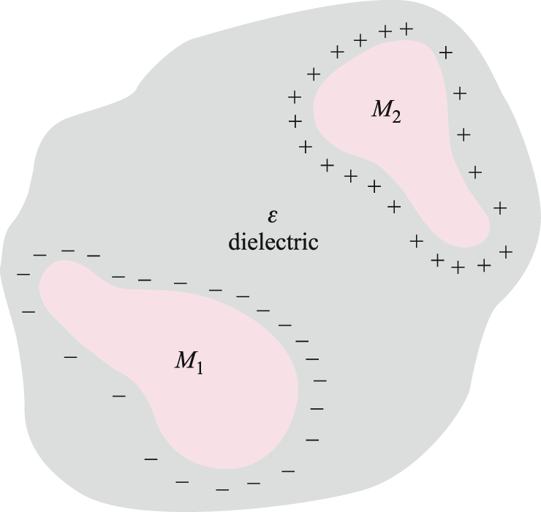
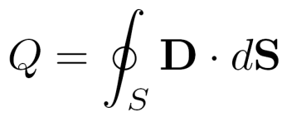
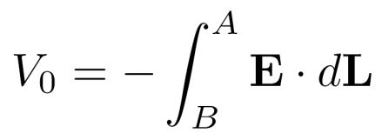

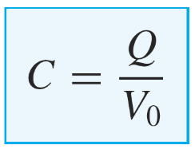
10: Capacitance
Capacitance defined
A simple capacitor consists of two oppositely charged conductors surrounded by a uniform dielectric.
An increase in Q by some factor results in an increase in E (and in D)
by the same factor.
S
Q
where
.
A
Consequently, the potential difference between conductors:
.
E, D
-Q
B
will also increase by the same factor -- so the ratio of Q to V₀ is a constant. We define the capacitance of the structure
as the ratio of the stored charge to the applied voltage, or
Units are Coul/V or Farads
4

Slide 6
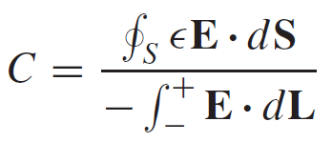
10: Capacitance
Capacitance defined
In general terms, we determine Q by a surface integral over the positive conductors, and we find V₀ by carrying a unit positive charge from the negative to the positive surface,
S
Q
.
A
The capacitance is independent of the potential and total charge, for their ratio is constant.
E, D
-Q
.
B
The capacitance is a function only of the physical dimensions of the system of conductors and of the permittivity of the homogeneous dielectric.
Capacitance is measured in farads (F), where a farad is defined as one coulomb per volt. Common values of capacitance are apt to be very small fractions of a farad, and consequently more practical units are the microfarad (μF), the nanofarad (nF), and the picofarad (pF).
5

Slide 7
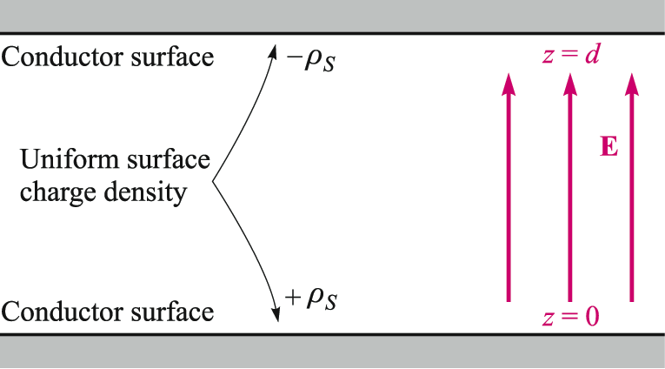
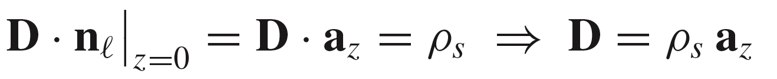
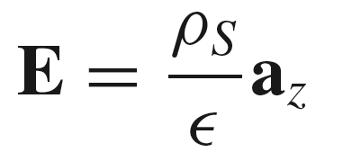
10: Capacitance
Parallel-Plane Capacitor
The horizontal dimensions are assumed to be much greater than the plate separation, d.
Therefore, electric field can be assumed to lie only in the z direction, and potential varies only with z.
Plate area = S
Apply the boundary for D at the surface of a perfect conductor:
Lower plate:
Same result either way!
Upper Plate:
The electric field between plates is therefore:
6

Slide 8
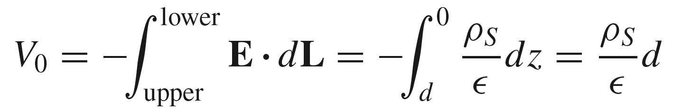
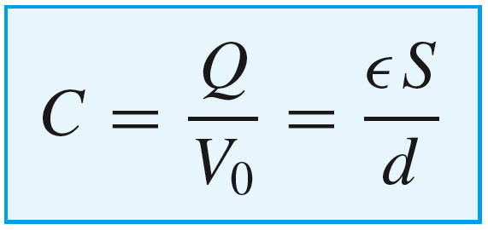
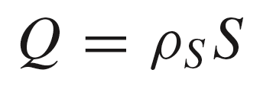
10: Capacitance
Capacitance of Parallel-Plane Capacitor
Plate area = S
Now with
The voltage between plate can be found through:
Then with
we finally obtain
7

Slide 9
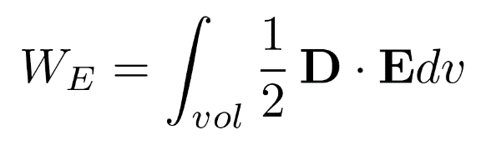
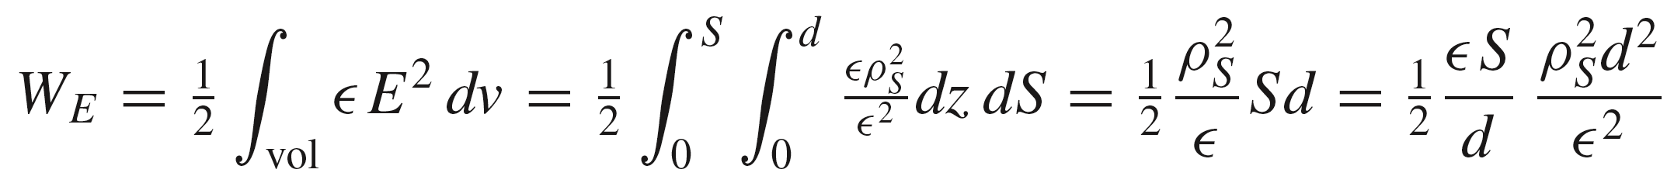
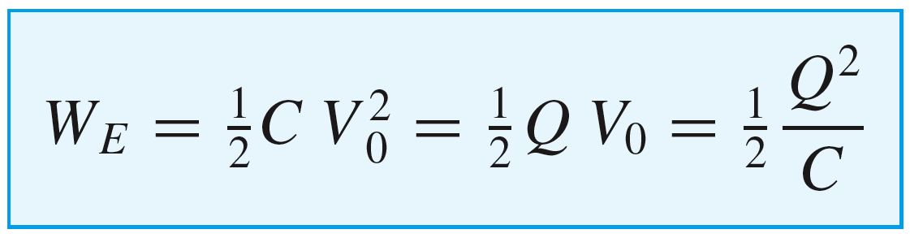
10: Capacitance
Energy Stored in Parallel-Plane Capacitor
or
S
There are three ways of writing the energy:
C
V₀²
8

Slide 10
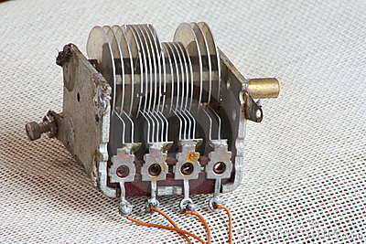
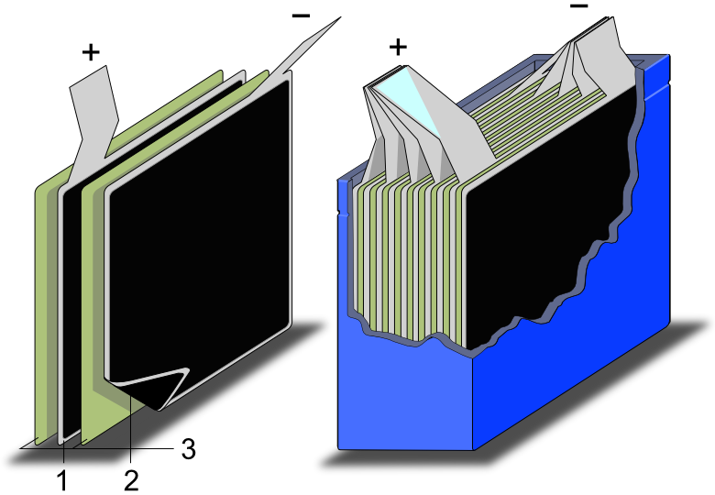
10: Capacitance
Parallel-Plane Capacitors in practical application
9

Slide 11
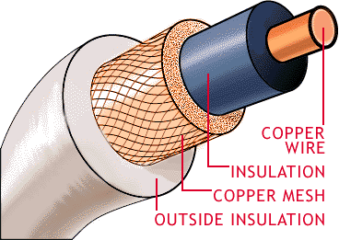
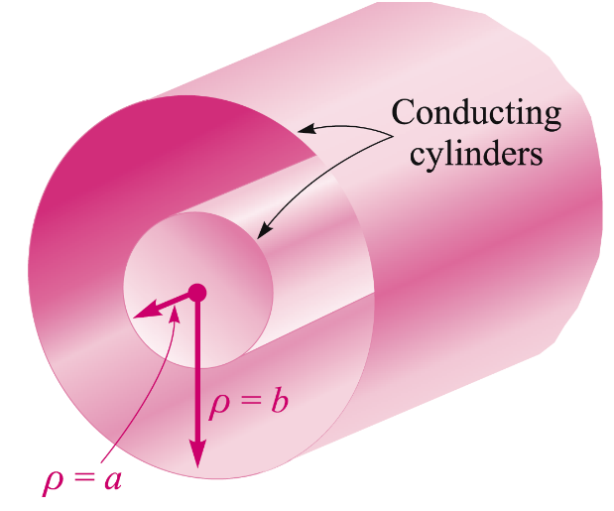
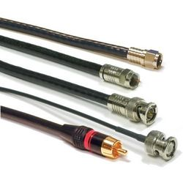
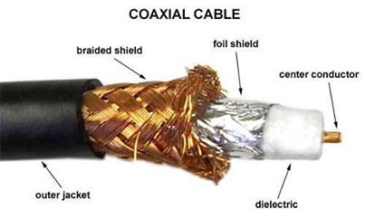
10: Capacitance
Capacitance in Coaxial Transmission Line
ρ_{S}
E
1
assume a unit length in z
10

Slide 12
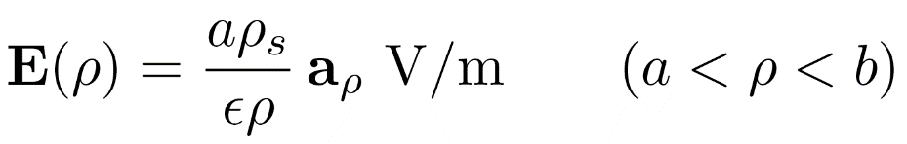
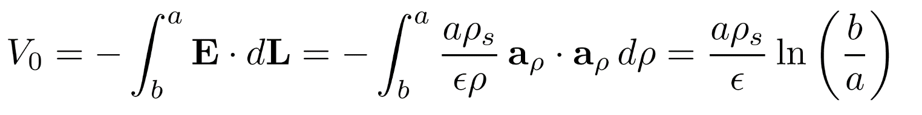

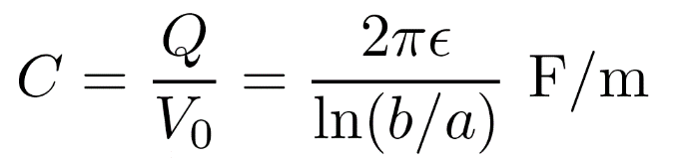
10: Capacitance
Capacitance in Coaxial Transmission Line
We previously found using Gauss’ Law:
ρ_{S}
E = 0 elsewhere, assuming a hollow inner
conductor, and equal and opposite charges
on the inner and outer conductors.
E
ε
1
The potential difference between conductors is now:
assume a unit length in z
…and the charge on the inner conductor per unit length is:
Finally:
11

Slide 13
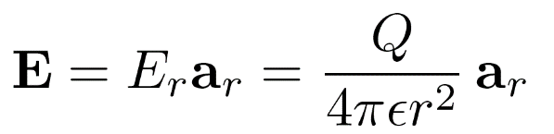
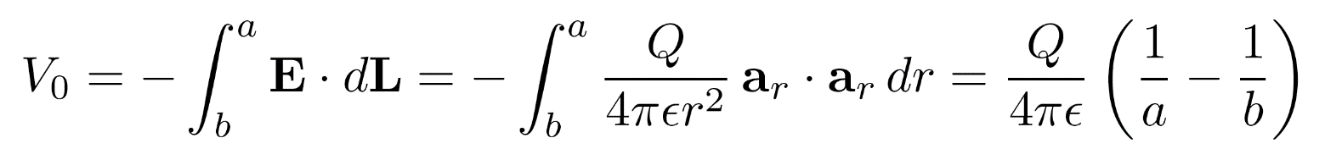


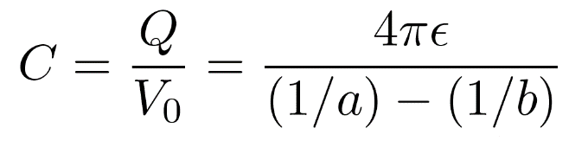

10: Capacitance
Capacitance in Spherical Capacitor
Consider two concentric spherical conductors, having radii a and b.
Equal and opposite charges, Q, are on the inner and outer conductors.
Gauss’ Law tells us that electric field will exist only in the
region between spheres, and will be given by:
E
a
-Q
Q
b
The potential difference between inner and outer spheres is then:
and the capacitance is:
Note that as
(isolated sphere)
Our earth is a huge capacitor!
12

Slide 14
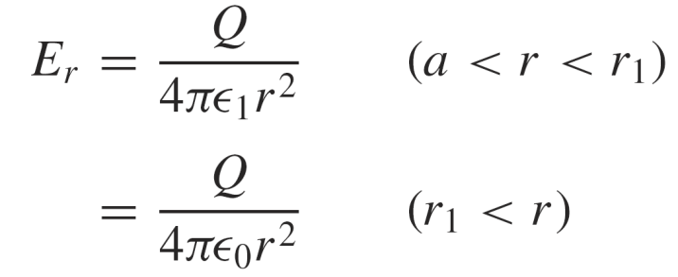
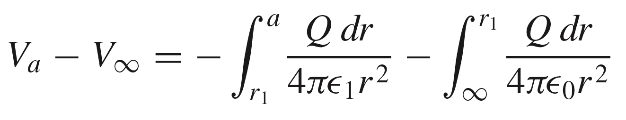
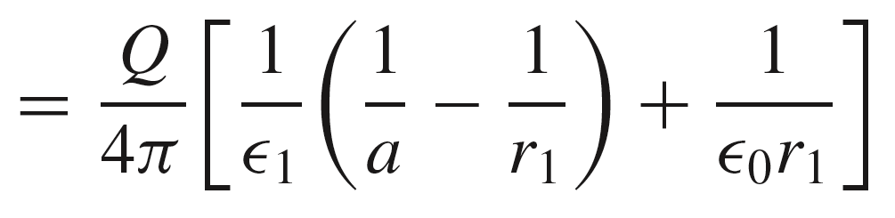
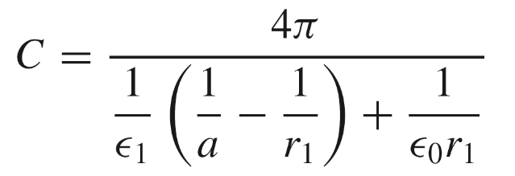
10: Capacitance
Capacitance in Isolated Sphere with a Dielectric Coating
A conducting sphere of radius a carries charge Q.
A dielectric layer of thickness r₁ - a and of permittivity ε₁
surrounds the conductor. Electric field in the two regions
is found from Gauss’ Law to be:
ε₀
ε₁
a
E₁
E₂
Q
r₁
The potential at the sphere surface is (with zero reference at infinity):
= V₀
and the capacitance is:
13

Slide 15
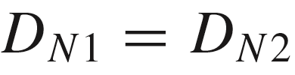


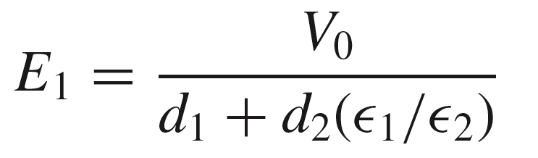
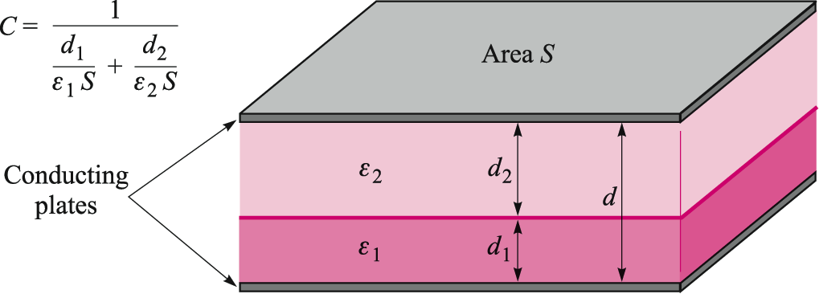
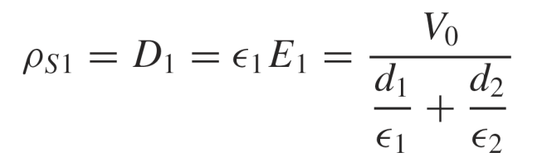
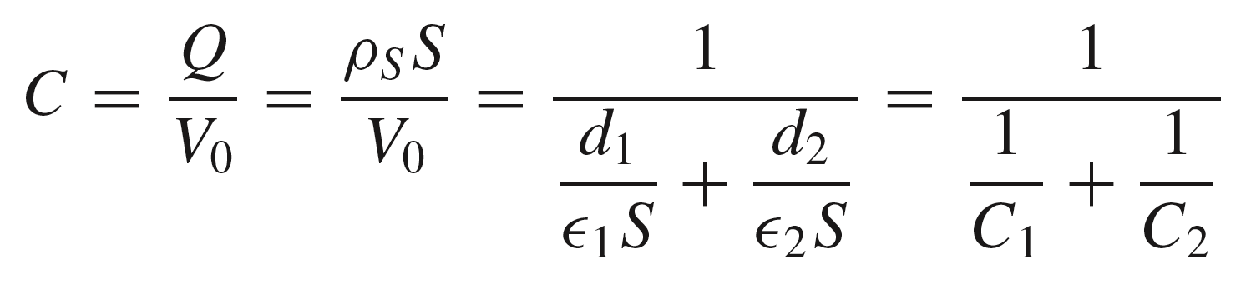
10: Capacitance
Capacitor with a Two-Layer Dielectric
In this case, we use the fact that D normal to an interface between two dielectrics will be continuous across the boundary, assuming no surface charge is present there:
Thus
and therefore:
The potential difference between bottom and top plates will be:
..which leads to:
The surface charge density on the bottom plate:
D_{N2}
E₂
D_{N1}
E₁
The capacitance is then:
14

Slide 16
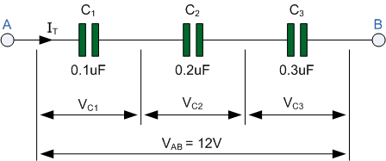
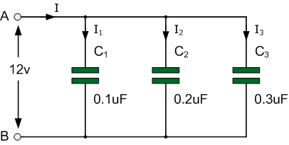


10: Capacitance
Capacitors in a Series / Parallel Connection
$$\frac{1}{\text{C}}=\frac{1}{\text{C}1}+\frac{1}{\text{C}2}+\frac{1}{\text{C}3}$$
$\text{C}$=C₁+C₂+C₃
15

Slide 17
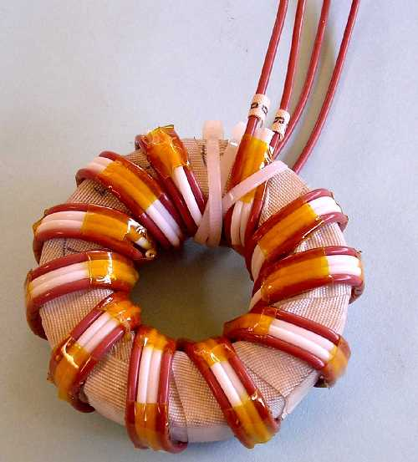
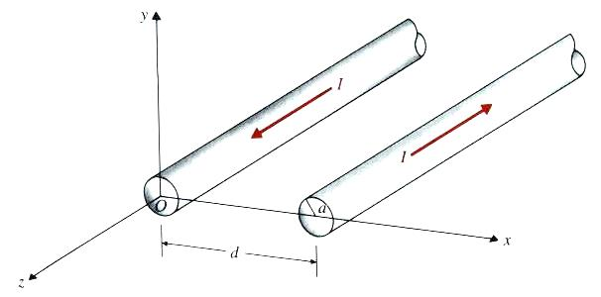
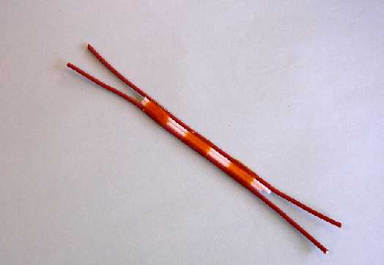
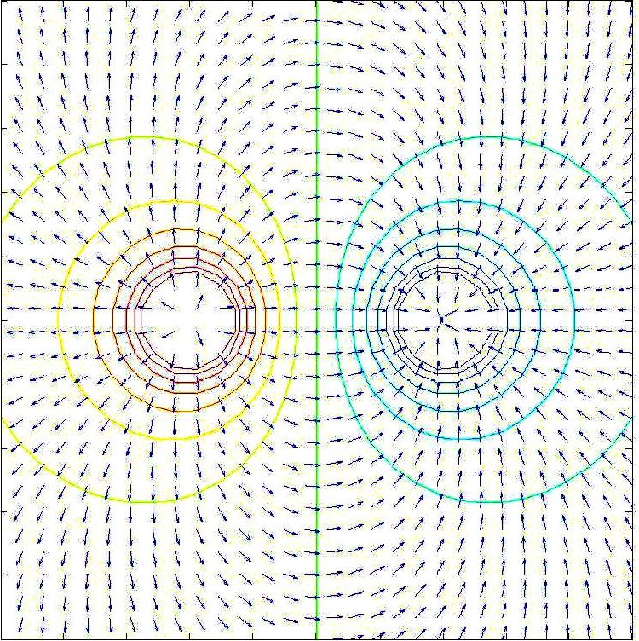
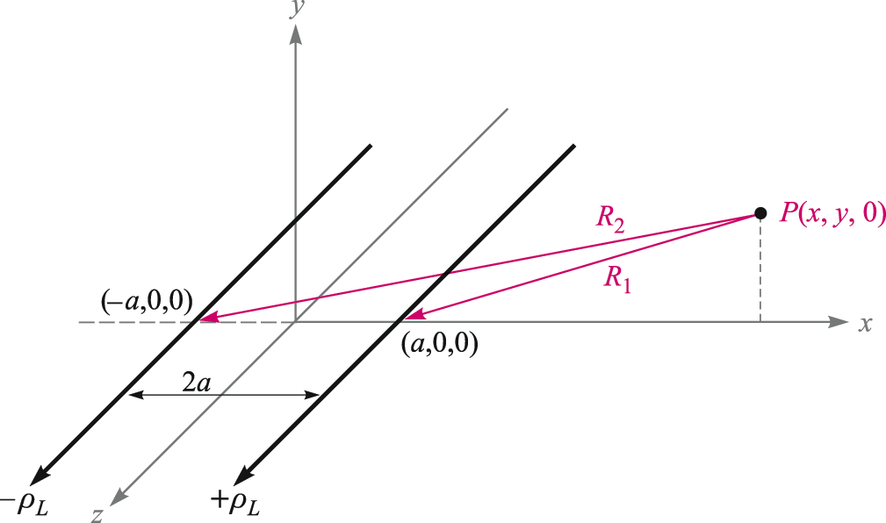
10: Capacitance
Capacitance in Two-Wire Transmission Line
16

Slide 18





8: Energy and Potential能量与电位
Potential difference in a line charge field
20

Slide 19


10: Capacitance
Capacitance in Two-Wire Transmission Line
We begin with the potential field of a single line
charge on the z axis, with a zero reference at ρ = R₀
We can use this result to write the potential at point P from two line charges of
opposite sign, positioned as shown:
17

Slide 20

10: Capacitance
Capacitance in Two-Wire Transmission Line
We now have:
18

Slide 21




10: Capacitance
Capacitance in Two-Wire Transmission Line
We now have:
Choose an equipotential surface on which V = V₁, and define the dimensionless parameter:
from which we identify:
This is the equation of the equipotential surface on which the voltage is V₁
To better identify the surface, expand the squares, and collect terms:
19

Slide 22


10: Capacitance
Capacitance in Two-Wire Transmission Line
The equation of an equipotential surface is:
This is the equation of a circle (actually a cylinder), displaced along the x axis by distance h,
and having radius b, where
and
It is all independent of z, as you might expect!
20

Slide 23





10: Capacitance
Capacitance in Two-Wire Transmission Line
Consider a grounded conductor in the y-z plane, and a conducting cylinder, parallel to the z axis, positioned as shown. The cylinder has radius b and center location h on the x axis, where
y
V = 0
and
Eliminate a between the two equations to get the quadratic:
V = V₀
Choose positive sign because it
leads to a positive value for a
b
x
whose solution is:
h
Then, substitute K₁ back into either starting equation to find:
21

Slide 24






10: Capacitance
Capacitance in Two-Wire Transmission Line
The expression
gives the location of an equivalent line charge, ρ_{l}
y
From the original definition, we now have
V = 0
from which
Now, given h, b, and V₀ , it is possible to find a, ρ_{l} , and K₁.
V = V₀
For a length L in the z direction,
.
ρ_{l}
b
a
h
x
So that finally:
The capacitance between two circular conductors separated by a distance 2h is
22

Slide 25
10: Capacitance
Capacitance in Two-Wire Transmission Line
Numerical Example
Choose b = 5 mm, h = 13 mm, and V₀ = 100 V. Find ρ_{l} and C.
23

Slide 26





10: Capacitance
Capacitance in Two-Wire Transmission Line
Numerical Example
Choose b = 5 mm, h = 13 mm, and V₀ = 100 V. Find ρ_{l} and C.
mm
Then:
Obtain:
and
23

Slide 27


10: Capacitance
Capacitance in Two-Wire Transmission Line
Numerical Example (Cont’d)
In this step, we find the 50-volt equipotential surface
First:
mm
mm
The resulting surface is the dashed red circle
24

Slide 28
10: Capacitance
Capacitance in Two-Wire Transmission Line
Numerical Example (Cont’d)
In this step, we find the 50-volt equipotential surface
First:
mm
mm
The resulting surface is the dashed red circle
24

